Slide 1
Key Component Resistant Temperature
JBD-VN-ME
2022/03/15

Slide 2
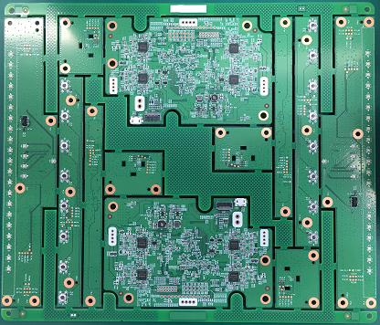
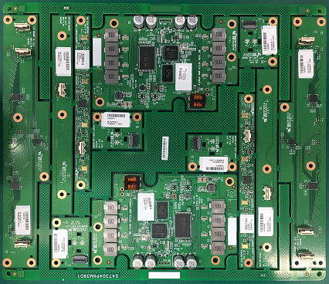
☆Key Component Resistant Temperature
Location | Description | Peak Temp(℃) | Time(s)
U6_3/MIC2,U6_4/MIC3,U6_5/MIC4,U6_2/MIC1 | MICROPHONE 2.3~3.6V 0.365mA 40+-1dB GP SPM0687LR5H-1 | 250 | 10
J6_1,J3_3,J3_2,J3_1,J1_1 | CONN FFC 15P 0.5mm SMD FEMALE RT GP | 250 | 10
J813 | CONN FFC 15PIN P=0.5mm SMD FEMALE RT GP | 250 | 10
J3_1
U6_5/MIC 4
J3_3
J3_2
J1_1
U6_4/MIC 3
J813
U6_2/MIC1
U6_3/MIC 2
J6_1
J6_1
J813
U6_2/MIC1
U6_3/MIC 2
U6_4/MIC 3
J6_1
J3_2
J3_3
U6_5/MIC 4
J3_1
Bottom side
Top side
Summary: 96.1531T00 product get some location Peak Temp 250 (℃) as above MAP.

Slide 3
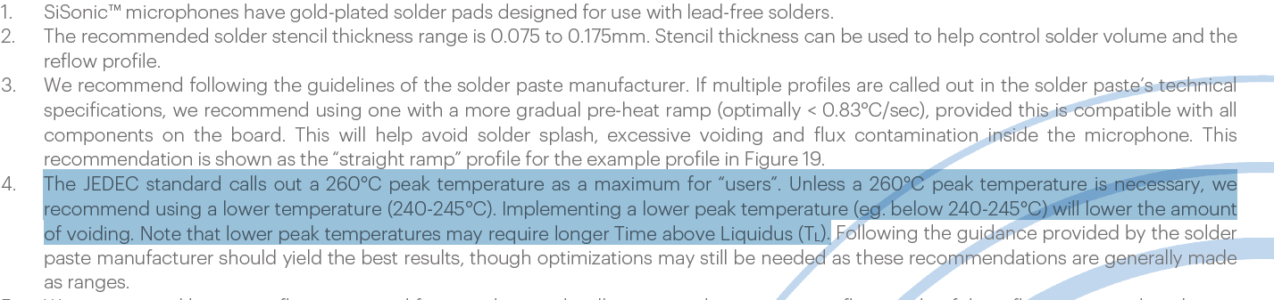
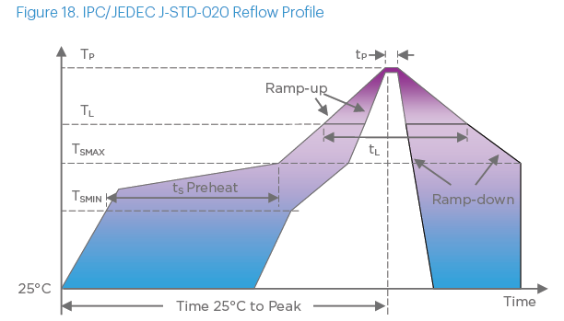
☆Key Component Resistant Temperature
U6_5/MIC 4
U6_4/MIC 3
U6_3/MIC 2
U6_2/MIC1
U6_2/MIC1
U6_3/MIC 2
U6_4/MIC 3
U6_5/MIC 4
Summary: With microphone component, Vendor recommend using a lower temperature (240-245°C) .

Slide 4
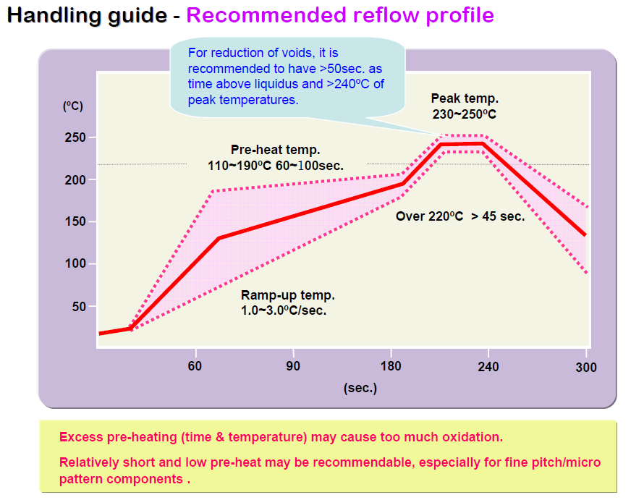
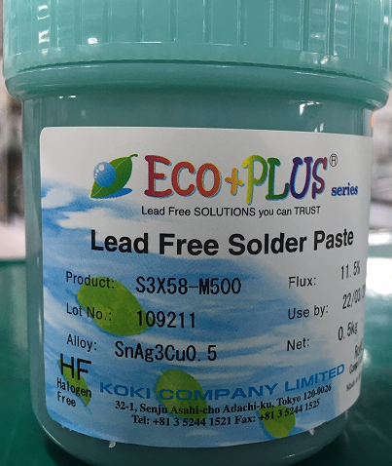
☆Key Component Resistant Temperature
Solder Paste: KOKI S3X58-M500
Summary: Our factory use Solder Paste: KOKI S3X58-M500 (591.00046.005) with Profile suggest as above table.

